Slide 1
Trends in Utility Service Centers
Service center planning needs to consider new practices in the industry and the operations these facilities support.
By Bob Lambe
& Keith McClanahan

Slide 2
Introduction
Why are Service Centers Changing?
How the industry works is changing, and the way service center facilities support these vital operations is evolving as well.
This paper is an overview of some past, present, and emerging changes in the electric utility industry that impact service center planning.
Similar industries such as gas, water, sewer, and communications have many of the same issues, but some details are specific to each particular industry.

Slide 3
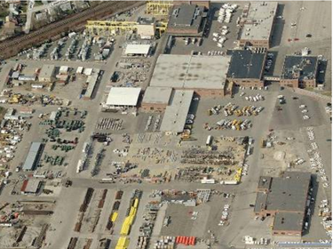
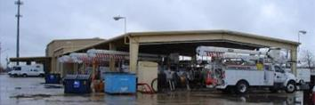
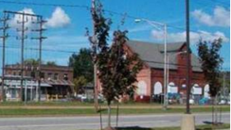
What is a Service Center?
Also called:
Operations work centers,
District headquarters,
Crew facilities, etc.
The primary function is not as much a place where work is done, as the place that supports work in the field.
Service centers range from large industrial complexes to small rural sites; some are no-frills and others reflect local architectural styles.

Slide 4
The Traditional Service Center
These types of facilities have traditionally been islands unto themselves, with a full complement of everything needed for the electric operation in the region:
Distribution and/or Transmission Crews.
Substation operations.
Meter reading.
Engineering/design & work planning.
Vehicle maintenance.
Material warehousing.
Dispatch, communications, and storm operations.
District management, environmental, & safety.
Customer service and bill payment office.
Community relations, business development.
Regional administration.

Slide 5
Same Old Changes...
Some changes have been going on for years:
Field work locations change:
As growth occurs.
As infrastructure ages.
Mergers change territories, consolidate administration
Re-organizations change work assignments/flow.
Technology improvements change work practices; reduce and centralize support staff:
Internet, computers/word processing allow central support.
Material handling booms and other equipment.
Proliferation of electronic devices increase customer sensitivity to outages.

Slide 6
Common Recent Trends...
Some types of changes are increasing:
The business environment is more demanding:
Just-in-Time delivery and 24/7 everything.
Increased cost reduction pressure.
Increased interest in sustainability.
Technology change is accelerating:
Improved diagnostics and dispatch.
Cell phones, GPS, and mobile devices.
Industry practices are more sophisticated:
More scheduled shifts, especially for first responders
“Mature” contractor environment (typically construction).
Use of separate storm/emergency response sites for large events.

Slide 7
What’s Next?...
Some types of changes are just emerging:
The “Smart Grid” and other IoT may improve system diagnostics and avoid/mitigate some issues.
Likely to increase dependence on communications.
Distributed generation (and MicroGrids) may reduce localized dependence on the grid for power.
Will battery power also provide real-time reliability?
Drones may provide rapid detection and even response.
Can the “first responder” be a flying robot?
3-D Printing may reduce need to carry some parts
...and many current trends/changes will continue

Slide 8
Implications for Service Center Planning
Still need service centers for foreseeable future
It is not feasible for large utility trucks to go home for most workers/locations.
Location requirements are becoming more about travel time (cost) than CAIDI (response)
First responders are already in field & using GPS dispatching
Major storm restoration using temporary logistic centers.
Facility design evolving into range of logistic support sites for field crews from autonomous regional HQs
Small/temporary sites provide local base for field crews only.
Larger sites provide regional operations such as direct crew support, working materials and required fleet maintenance.
Some functions centralized (dispatch, engineering) for efficiencies where technology allows.
Other functions may be co-located based on space availability.

Slide 9
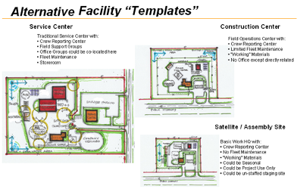
An Evolving Service Center Approach
Good location, flexible building, and adequate yard area are most important.
Many companies are “templating” service centers to improve consistent work practices for safety, effective support, and cost control.
The evolution (and philosophy) of which functions to centralize varies by organization.
There are many stakeholders and work process issues associated with these vital field operations.

Slide 10
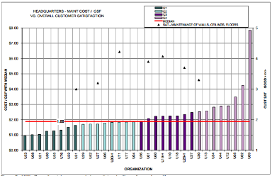
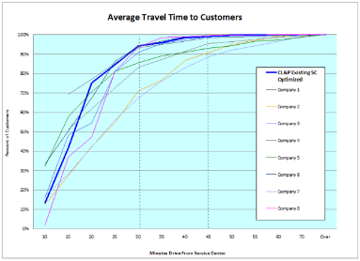
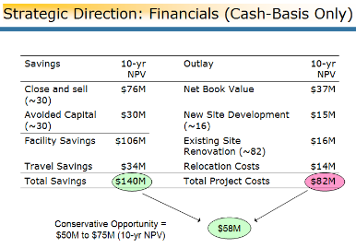
How Can You Prepare?
Know Where You Stand
Benchmark your service center facilities https://facilityissues.com/utilities-council/
Benchmark your travel time https://facilityissues.com/utilities-council/participation-options/service-center-benchmarking/
Do a long-range facility plan for your service centers https://facilityissues.com/utilities-council/participation-options/service-center-benchmarking/service-center-planning/
Plan for Change
Share best practices with your peers
Anticipate change when making investments in service center facilities
Start Educating Stakeholders
Regulators, management, employees, customers, shareholders

Slide 11
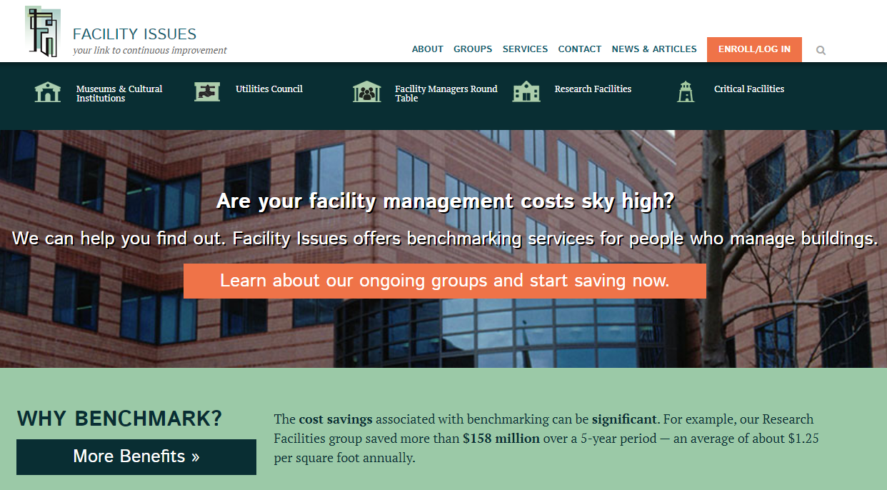
Read more about utility facility benchmarking or signup to participate: https://facilityissues.com/utilities-council/
Email or call with questions:
Rlambe@FacilityIssues.com 315-601-6010

